Slide 1
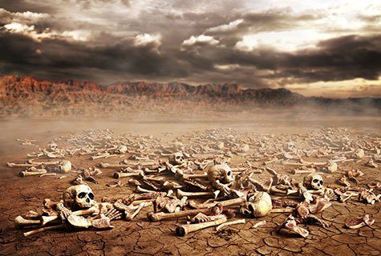
Ezekiel
“Ye Shall Know That I Am The Lord”

Slide 2
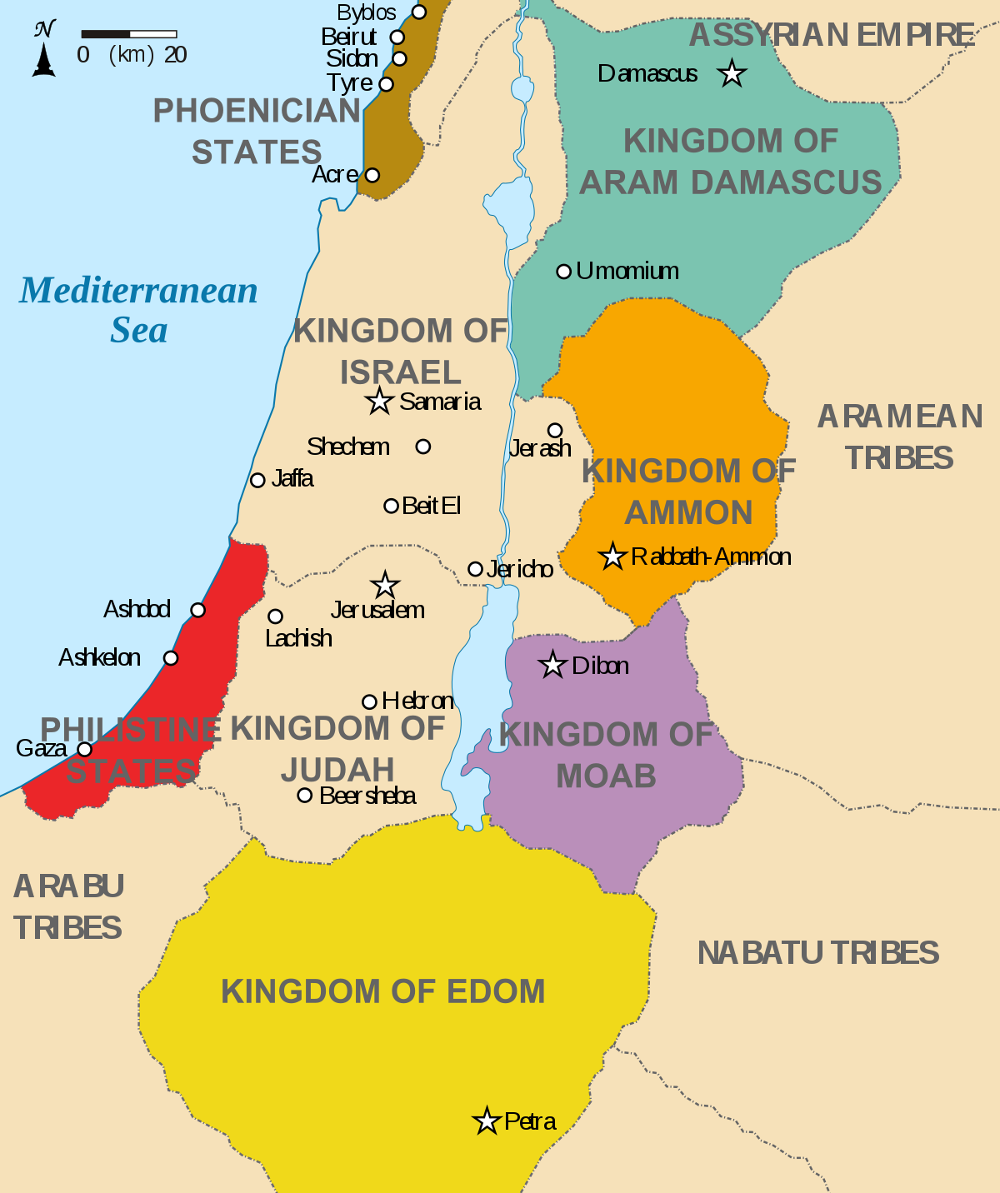
Prophecies Against Neighboring Nations (Ezekiel 25)
The nations named and condemned in this chapter were the bordering neighbors of Israel –Ammon, Moab, Edom, and Philistia.

Slide 3

Ezekiel
Lessons 15 – Ezekiel 25-26
Prophecies Against Neighboring Nations (Ezekiel 25)
Ammon’s attitude toward God’s people condemned her (25:1-7)
Moab is condemned for claiming that Judah was no different than other nations (25:8-11)
  Nebuchadnezzar came against Ammon & Moab in 581 BC
Edom’s history of vengefulness toward Israel condemned her (25:12-14)
God would punish Philistia for her perpetual hatred and vengefulness against Israel (25:15-17)

Slide 4
Ezekiel
Lessons 15 – Ezekiel 25-26
Prophecy Against Tyre (Ezekiel 26)
Tyre is condemned because she gloated over the fall of Jerusalem (26:1-2)
The prophecy includes details of several unlikely occurrences:
  Many nations coming against Tyre
  It would be made a bare rock
  It would become a place for spreading nets in the midst of the sea
  Nebuchadnezzar would destroy the mainland city and villages
  The city would not be rebuilt

Slide 5
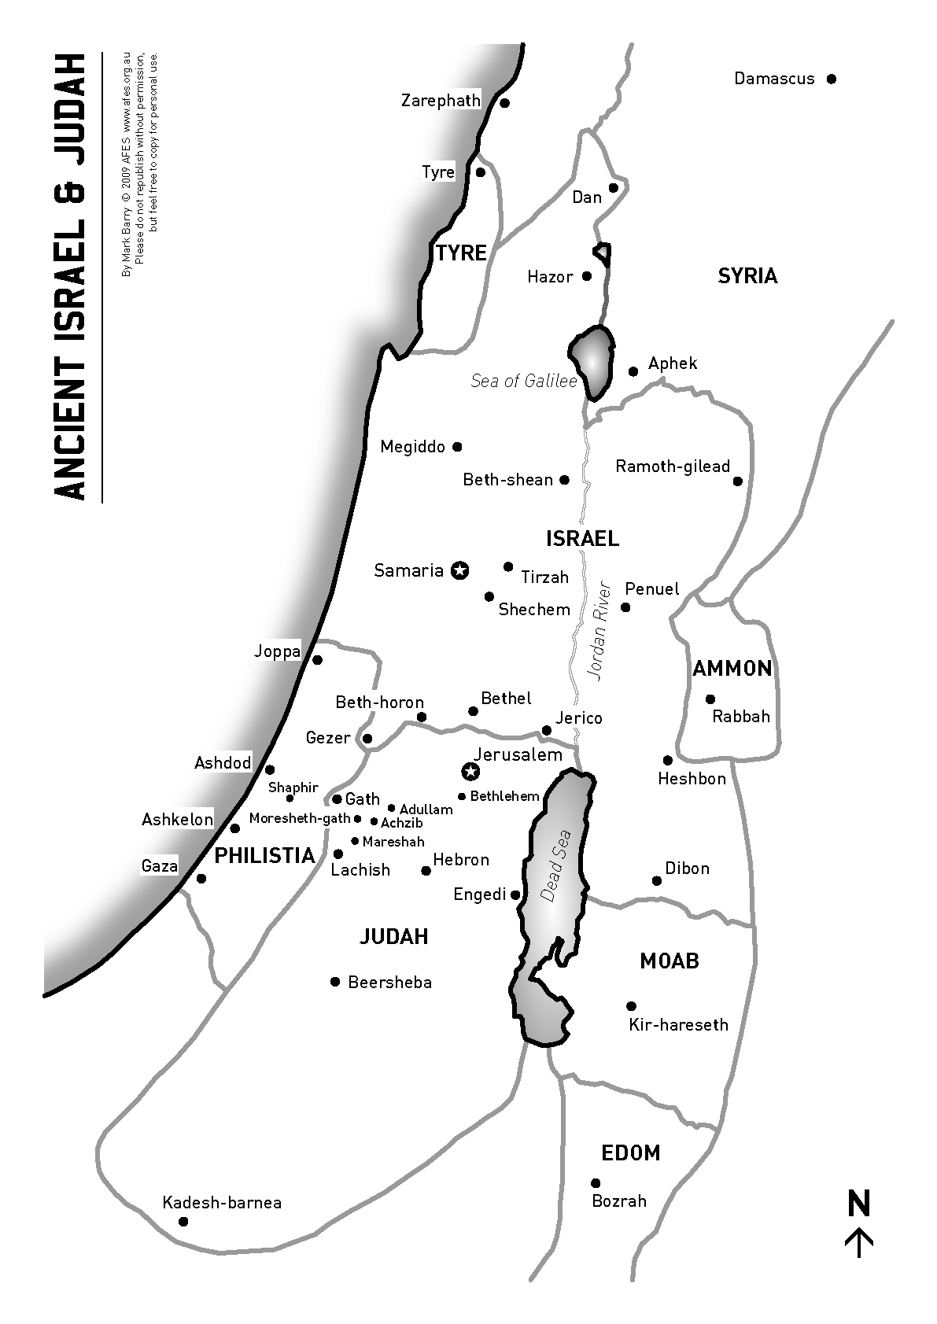
The prophecy against Tyre found in Ezekiel 26:3-5 and 11-14 was fulfilled in detail by Alexander the Great during his campaign through Palestine in 332 BC

Slide 6
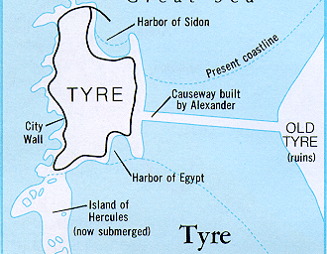
Alexander wished to make a personal sacrifice in the temple of Heracles on the island city of Tyre. Apparently, because the Tyrians considered their island refuge virtually impregnable, they refused his request. Upon receiving their refusal, Alexander immediately set to work on a plan to conquer the city. He set upon the task of building a land bridge or cause way (Siculus calls it a “mole”) from the mainland city of Tyre to the island city. Siculus stated: “Immediately he demolished what was called Old Tyre and set many tens of thousands of men to work carrying stones to construct a mole” (17.40). This unprecedented action took the Tyrians by complete surprise. And yet, even though this action was unprecedented militarily, it was exactly what one might expect from the description of the destruction of Tyre given by Ezekiel hundreds of years before. The mainland city was demolished and all her stones, timber, and soil were thrown into the midst of the sea. (Kyle Butt, AplogeticsPress.org., Tyre in Prophecy, 2006)
The Ancient historian Diodorus Siculus lived from 80-20 B.C. and wrote extensively of Alexander the Great’s dealing with Tyre. The information at right is derived from what Siculus wrote.

Slide 7
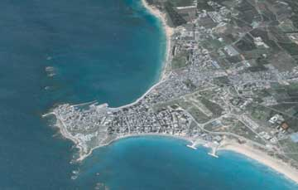
Aerial photo of modern Tyre

Slide 8
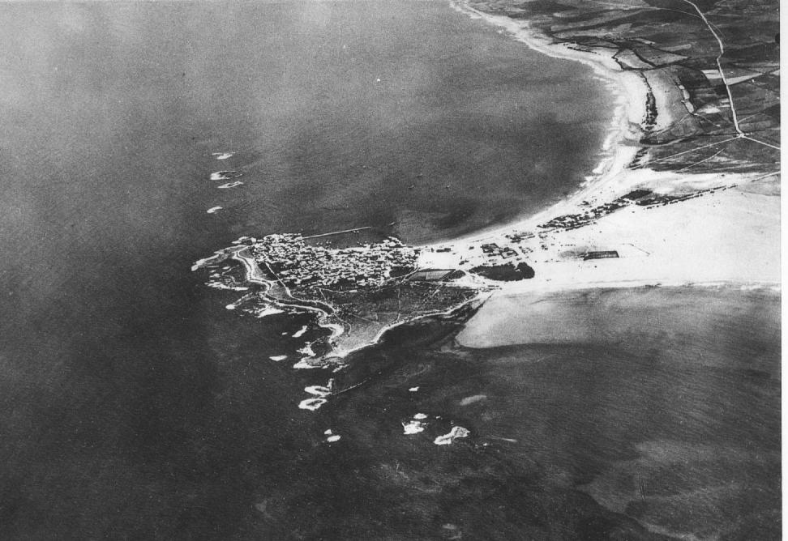
Aerial photo of Tyre taken in 1934

Slide 9
Ezekiel
Lessons 15 – Ezekiel 25-26
Prophecy Against Tyre (Ezekiel 26)
The actions of Nebuchadnezzar’s army are detailed in Ezekiel 26:7-11
  Ezekiel later became aware of the fact that Nebuchadnezzar’s army did not complete the destruction of Tyre (29:18)
  Josephus, quoting “the records of the Phoenicians,” says that Nebuchadnezzar “besieged Tyre for thirteen years in the days of Ithobal, their king” (Against Apion, 1.21).

